Slide 1


Data Science with Python
Noble Xavier

Slide 2
Assumptions for Simple Linear Regression
Data Should be linear – X increase Y also increase/ decrease
Data Should be homoscedastic (no outliers in the data)
Log transformation
No endogeneity – Missing important variables/values (to predict the house price- not considering the house price of the city
No auto correlation (there should not be any trend – Monday Sales less Friday more etc
No multicollinearity
x1 related to y , x2 related to y ,if x1 and x2 are related consider only one variable for prediction. House rice related to area , house price related number of rooms
Variance Inflation Factor (VIF) to address multicollinearity
Y = m1x1+m2x2+c

Slide 3
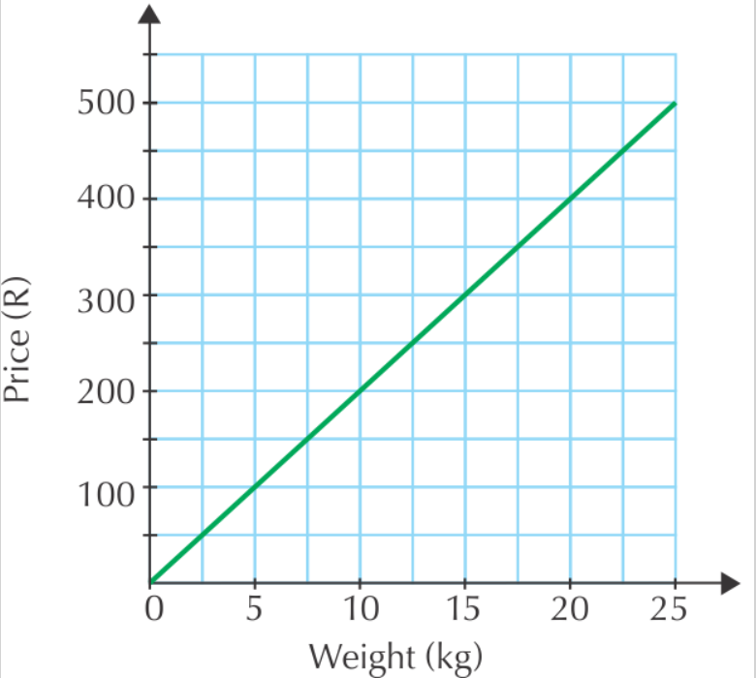
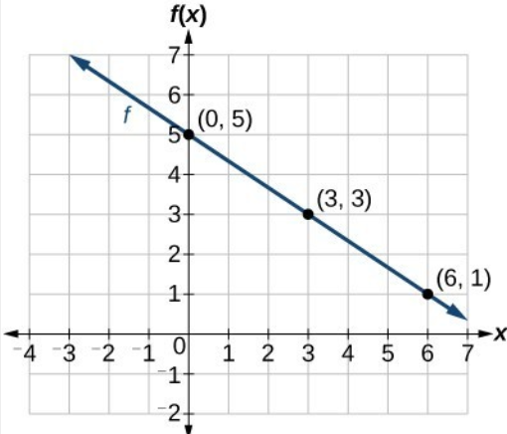
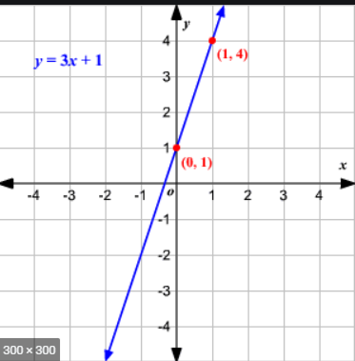
Linear Data

Slide 4


Slide 5
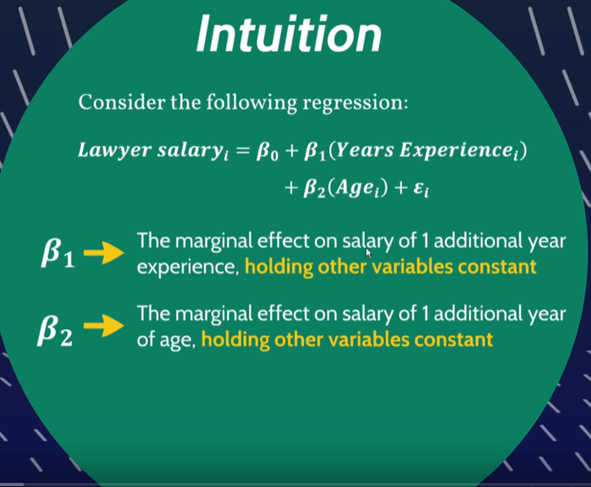

Slide 6
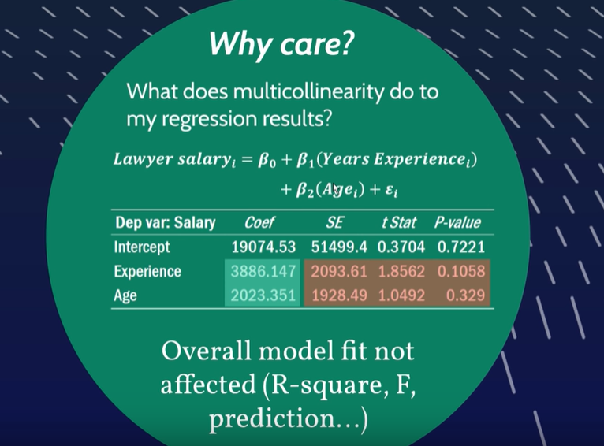

Slide 7
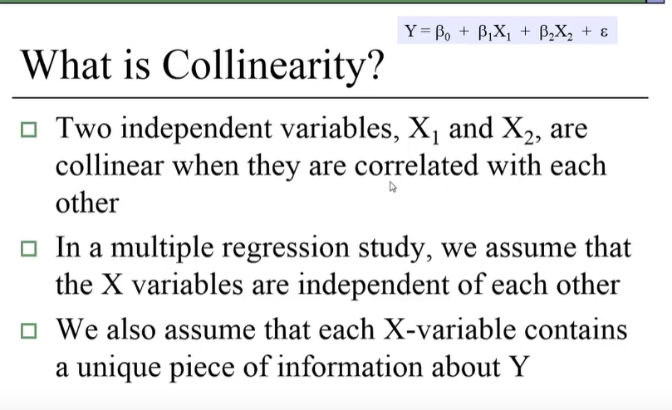

Slide 8
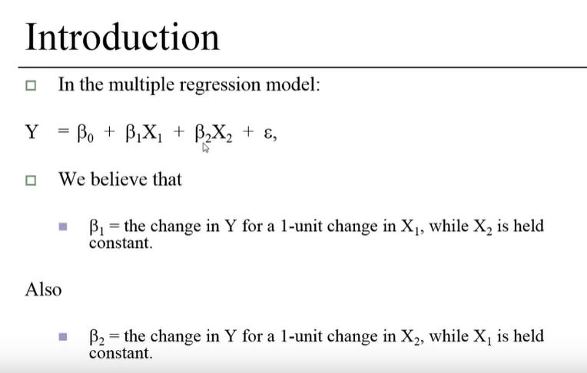

Slide 9
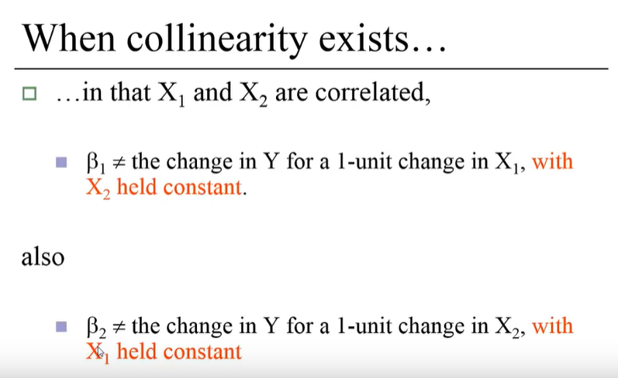

Slide 10
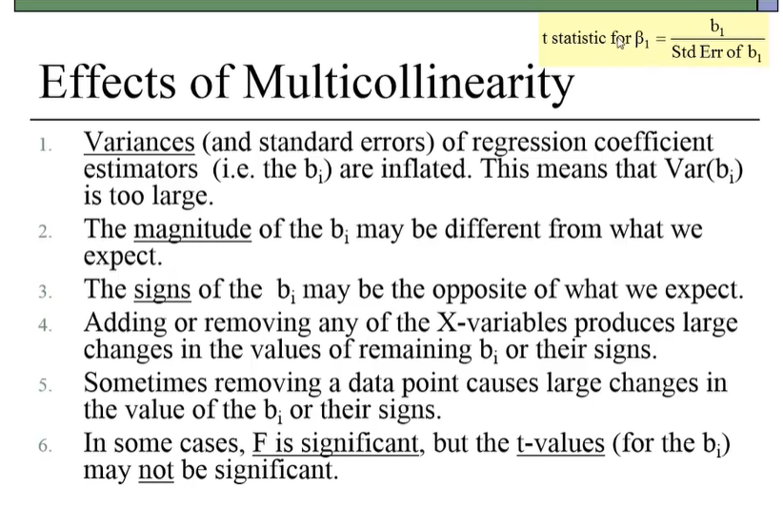

Slide 11
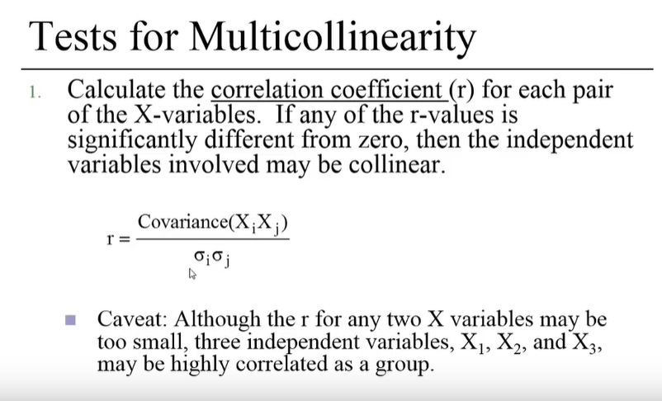

Slide 12
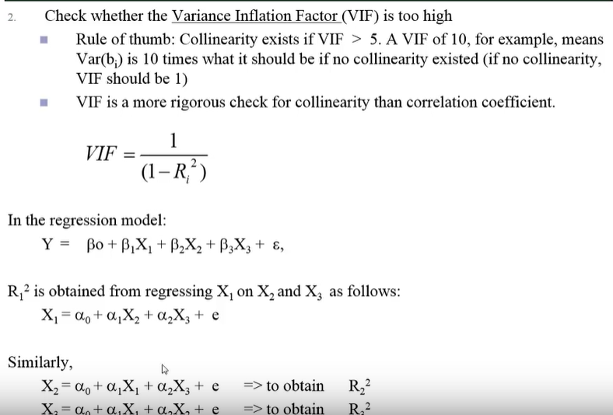

Slide 13
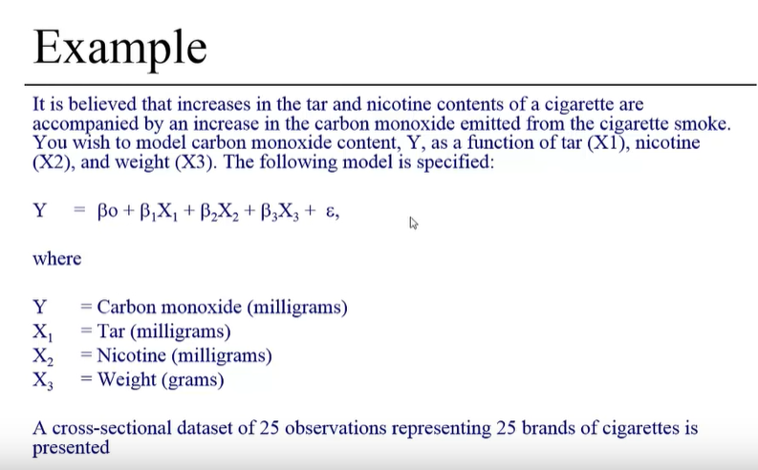

Slide 14
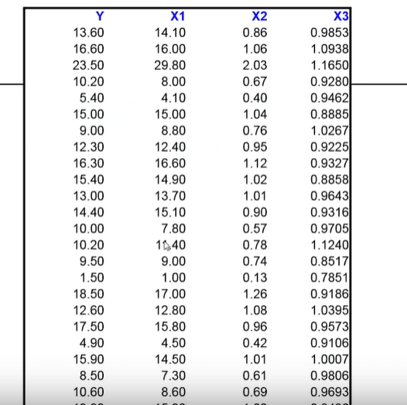
Data Set

Slide 15
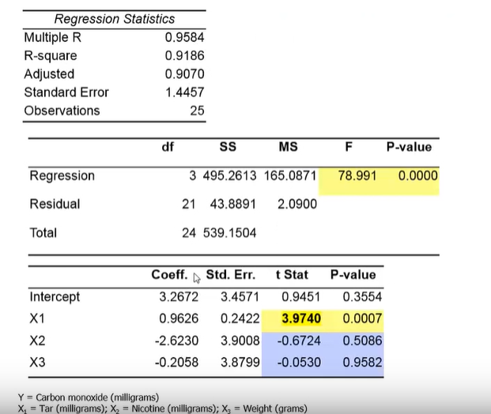

Slide 16
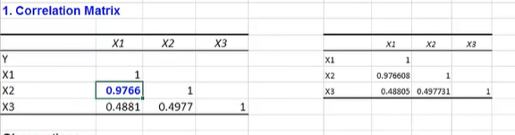
X1 and X2 are highly related there value is almost nearing 1

Slide 17
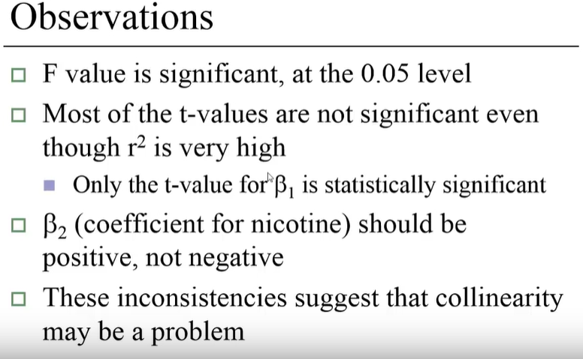

Slide 18
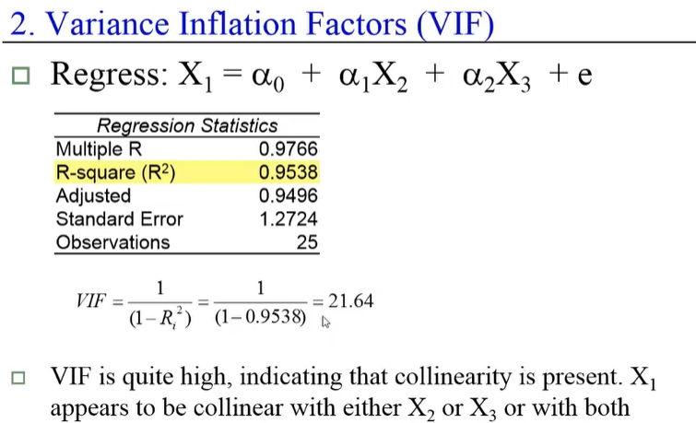

Slide 19
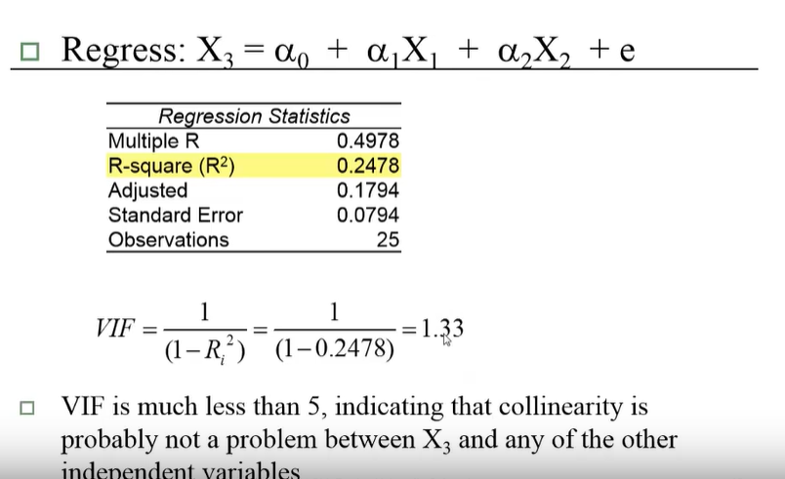

Slide 20
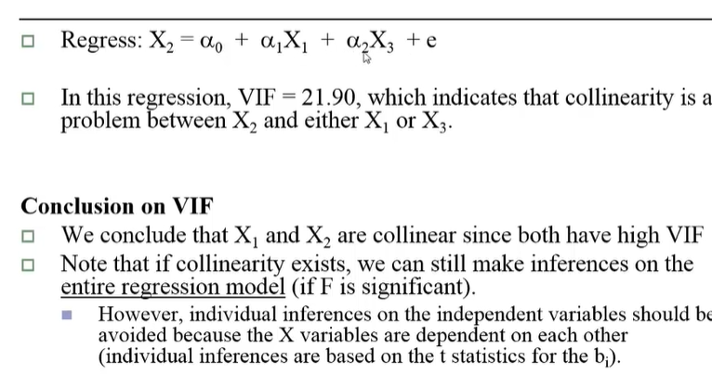

Slide 21
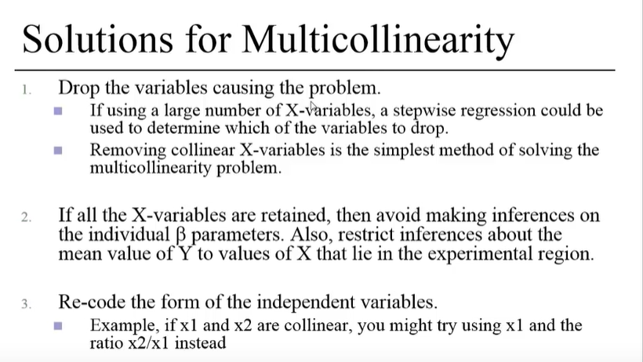

Slide 22
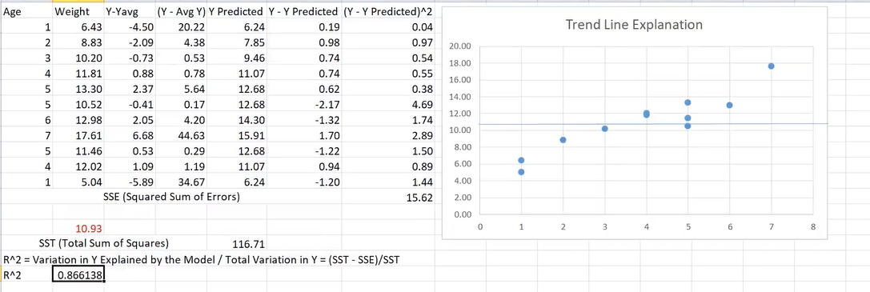
Accuracy of Simple Linear Regression

Slide 23
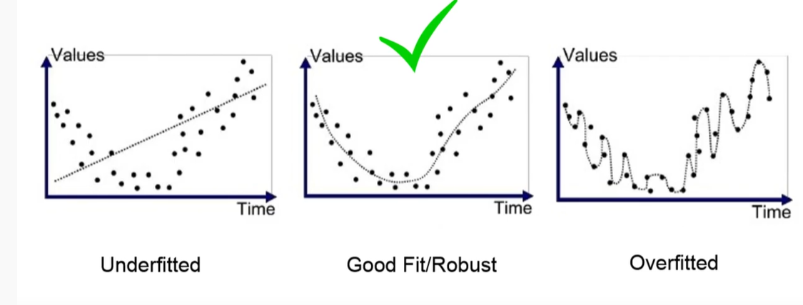
Under Fit /Over Fit

Slide 24
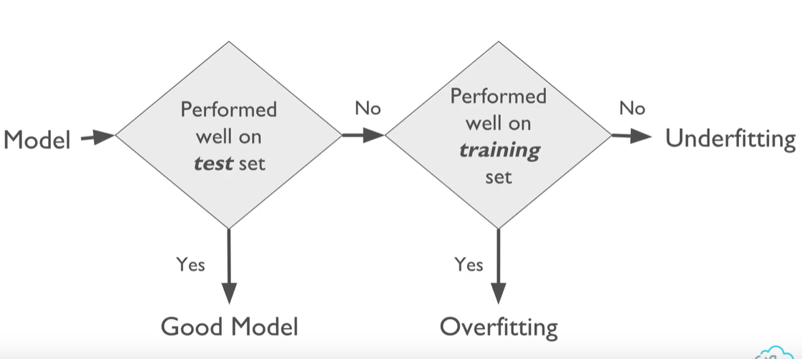
Under Fit /Over Fit

Slide 25
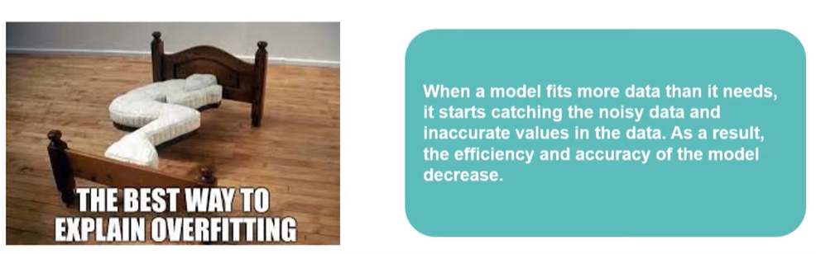
Over fitting

Slide 26
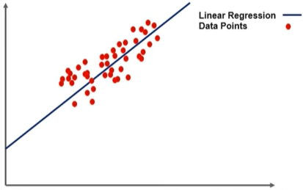
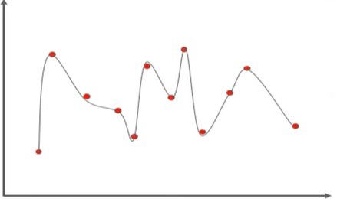
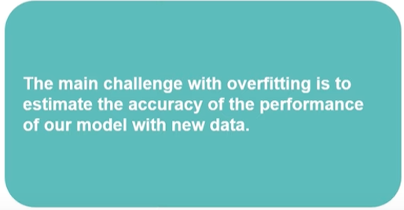
Linear Model
Over Fitting

Slide 27
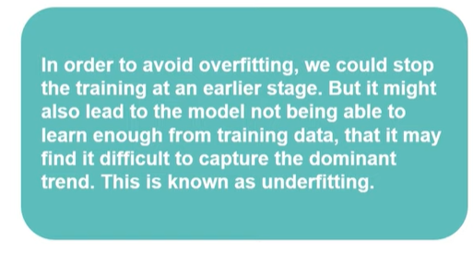
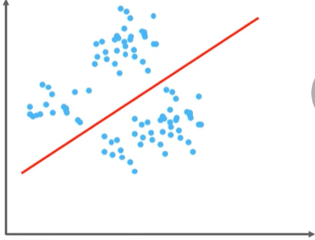
Under fitting
Under Fitting

Slide 28
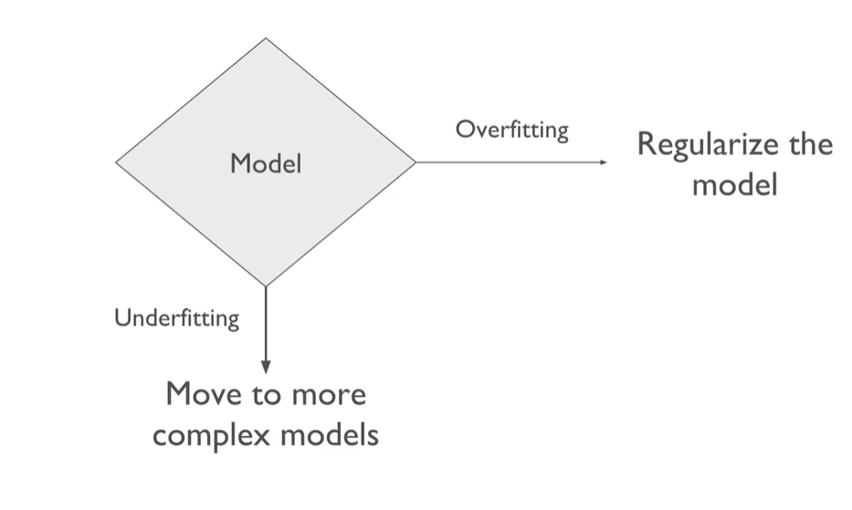

Slide 29
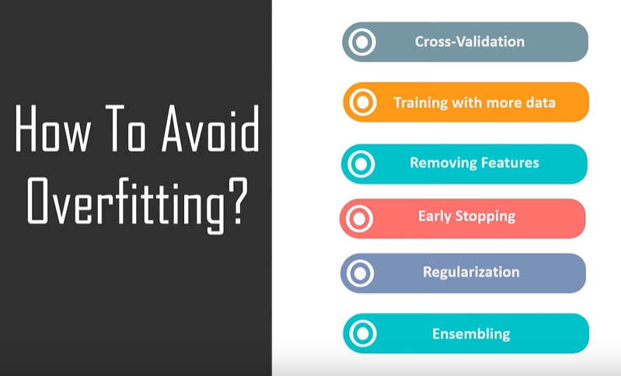

Slide 30
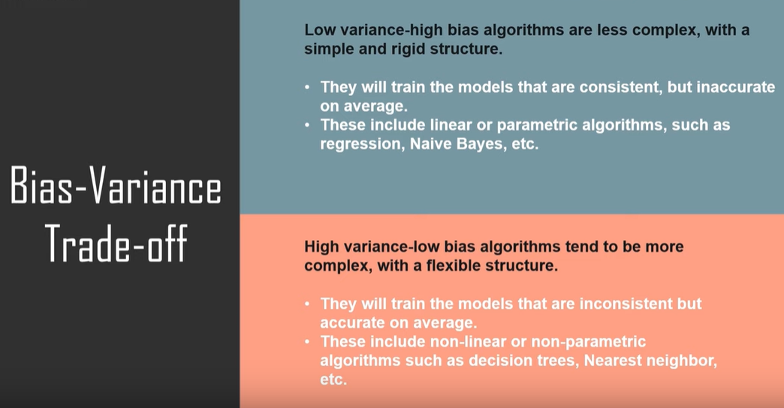

Slide 31
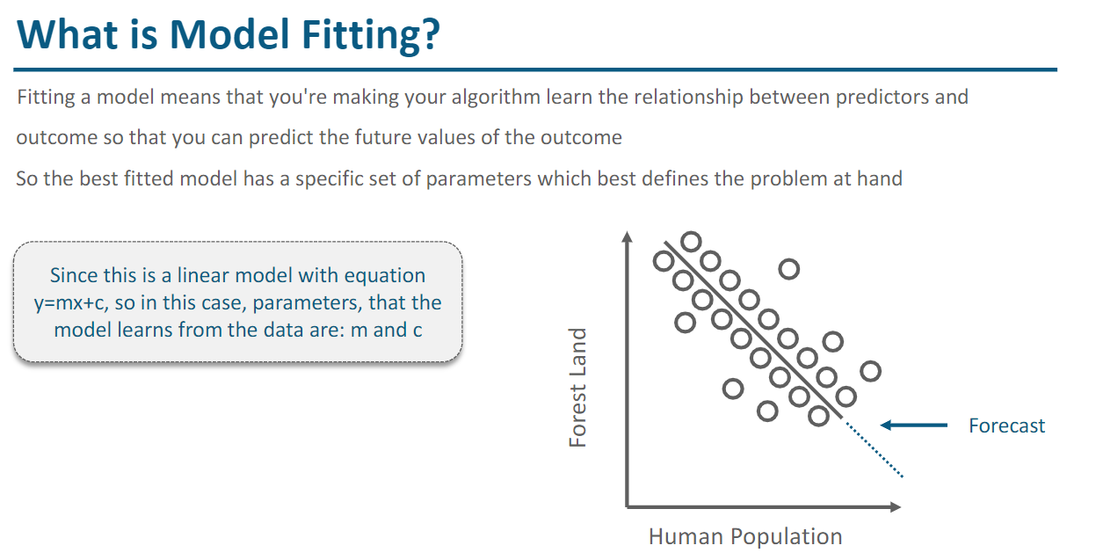

Slide 32
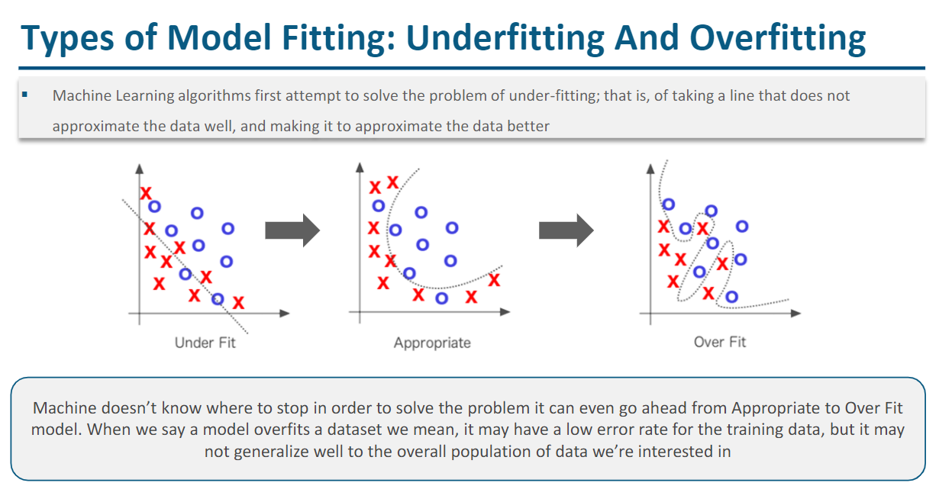

Slide 33
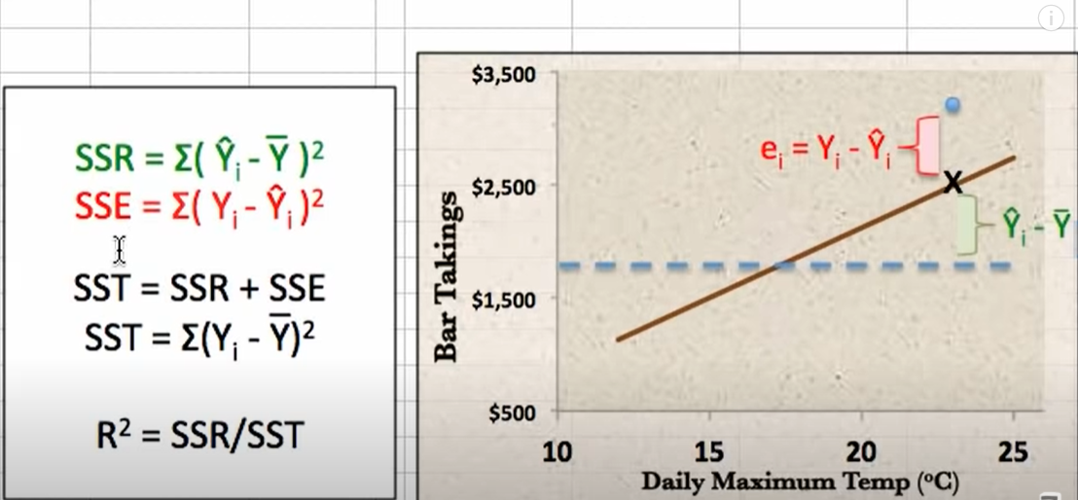

Slide 34
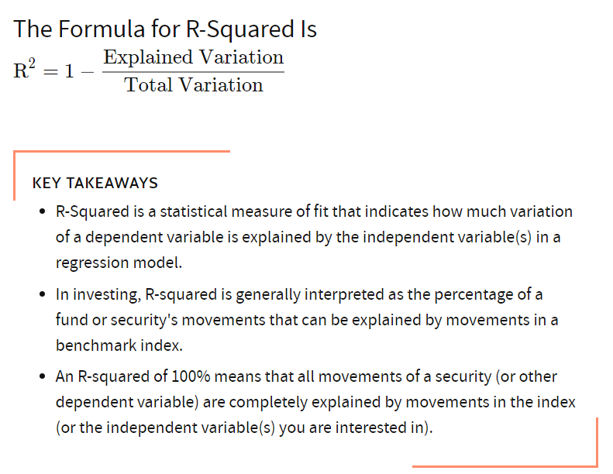

Slide 35
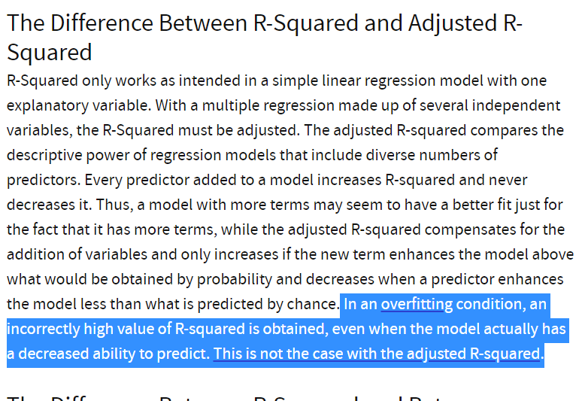

Slide 36
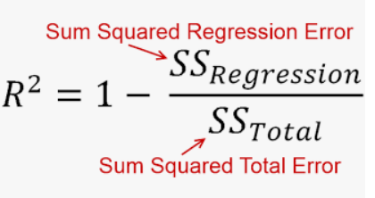
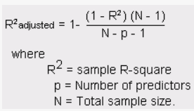
R2 and Adjusted R2

Slide 37
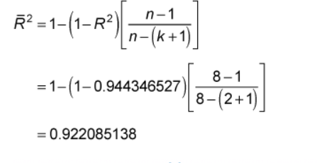
Adjusted R square for multiple linear regression
Adjusted R Square for multiple independent variable
Addition on each independent variable decreases the Adjusted R Square
Formula
n = the sample size
k = the number of independent variables in the regression equation
R Square = R Square value
Increase number of K – Adjusted R square value decreases

Slide 38
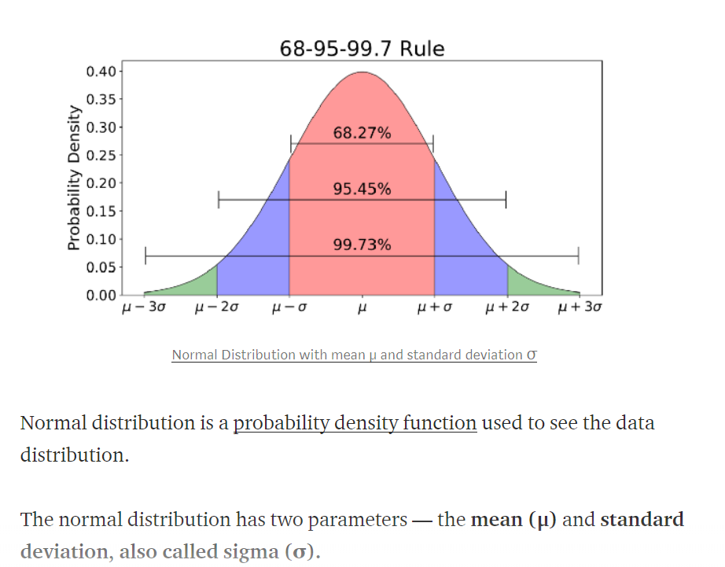
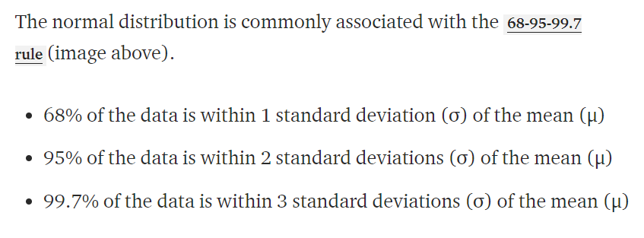
Normal Distribution

Slide 39
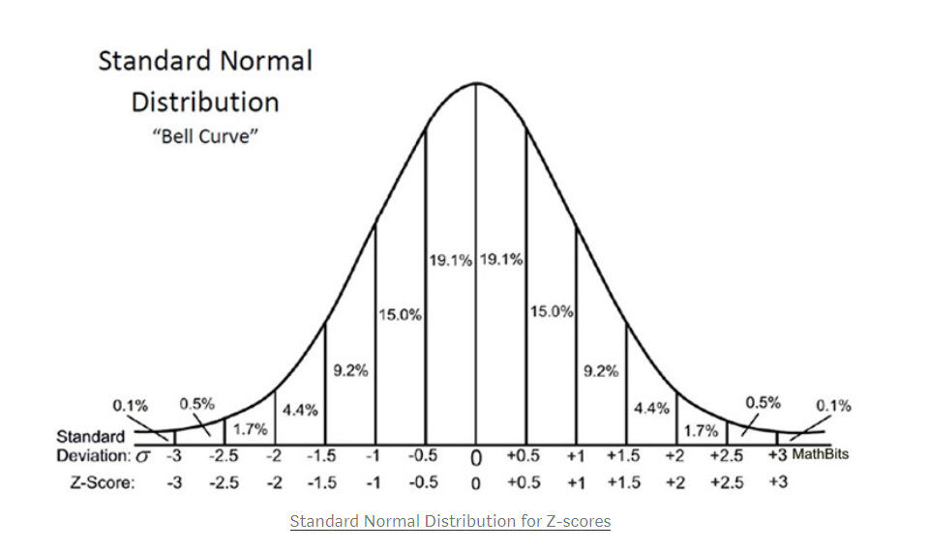

Slide 40
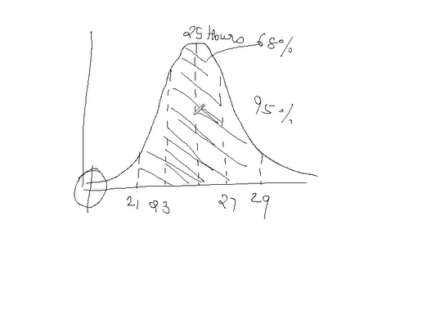
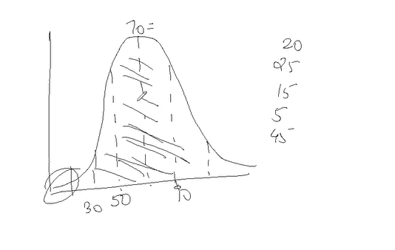
Hypothesis testing Example
Average time – 25 hours watch TV with Standard deviation 2
Next sample – 12 hours watch TV
Conclusion , value changed
95 % of the data between 21 and 29
Average runs 70 with standard deviation 20 runs.

Slide 41

Hypothesis Testing

Slide 42
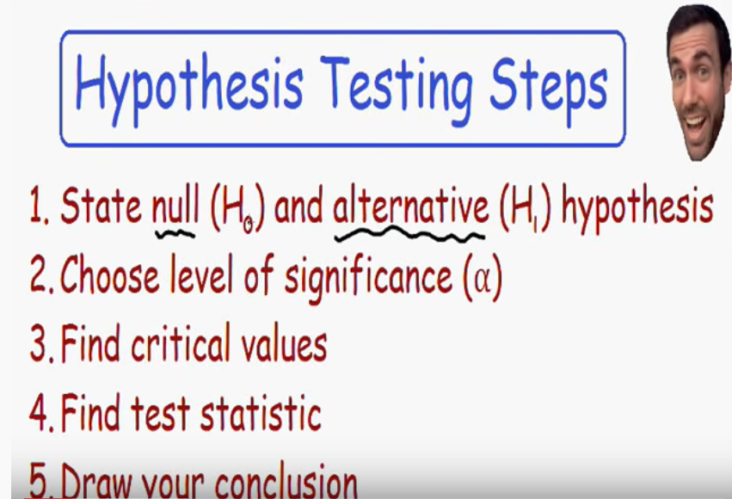

Slide 43


Slide 44
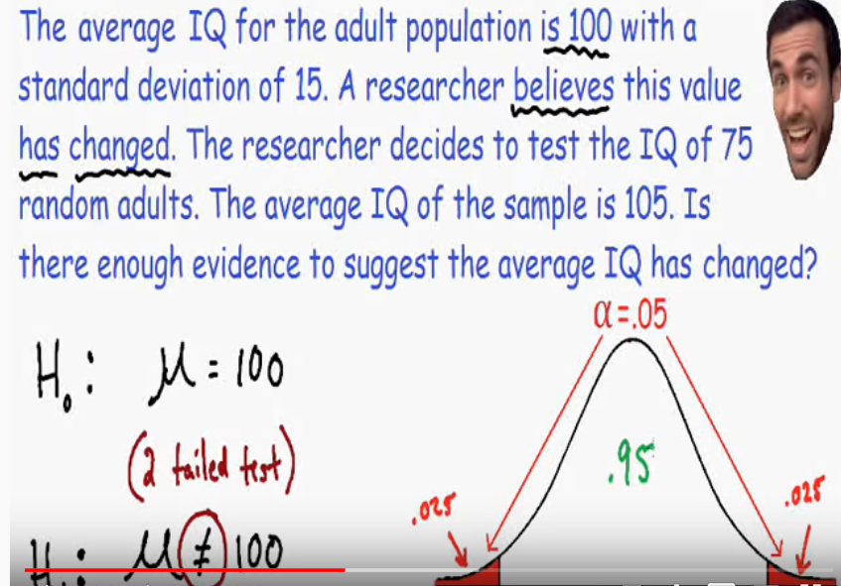
Level of Significance 0.05

Slide 45
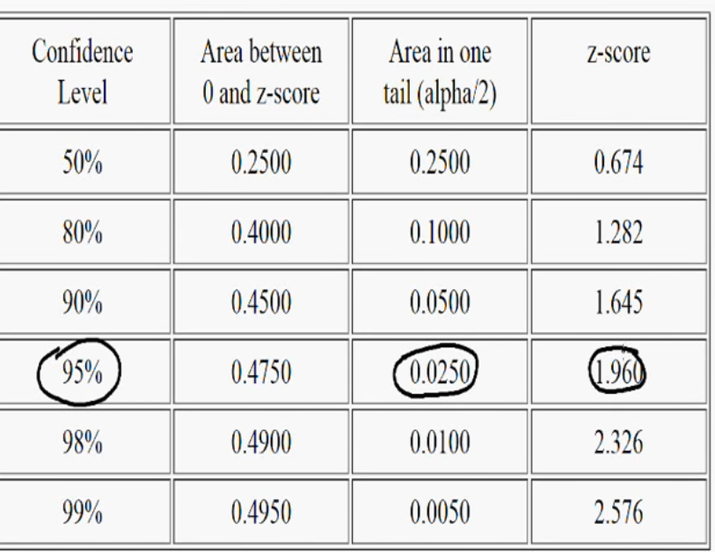
Critical Values

Slide 46
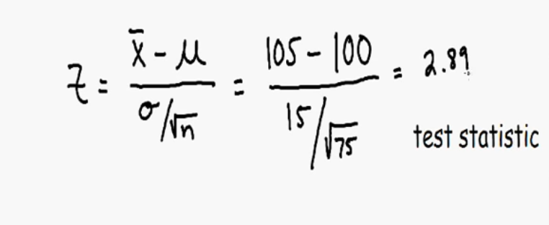

Find Test Values
2.89 value in the greater than 2.5 . So this lies in the red area(rejection area) .

Slide 47
Conclusion
2.89 is greater than 2.5 . This lies in the red area(rejection area) . That means we need to reject the null hypothesis ie IQ is 100. ie these a change in IQ level
P Values: If P value is greater than 0.05 accept the hypothesis else reject it
Hypothesis : Coefficient of each variable is Zero ( x1 ,x2 ,x3 ,x4,x5 are Zero)

Slide 48

Example 2

Slide 49
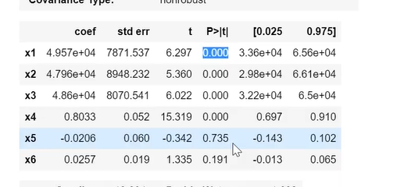
P Value
Null Hypothesis – Coefficient is Zero
Alternate Hypotheses – Coefficient is not zero
When P > 0.05 – Reject null hypothesis
Important variables are the variables which has p value less than 0.05

Slide 50

OLS

Slide 51
OLS
https://jyotiyadav99111.medium.com/statistics-how-should-i-interpret-results-of-ols-3bde1ebeec01
https://medium.com/analytics-vidhya/how-to-interpret-result-from-linear-regression-3f7ae7679ef9

Slide 52

First Part(model Summary) Interpretation

Slide 53

First Part(model Summary) Interpretation

Slide 54

First Part(model Summary) Interpretation

Slide 55

First Part(model Summary) Interpretation

Slide 56

First Part(model Summary) Interpretation
Degree of Freedom: In this case degree of freedom is 1. It is calculated by subtracting the number relations (independent variables) from number of observations. In the below case there are two independent variables represented in a two dimension space, number of observations three ( 3-2 =1)

Slide 57

First Part(model Summary) Interpretation
Degree of Freedom= 2
4 (number of observations) – 2 (independent variables) = 2

Slide 58

First Part(model Summary) Interpretation
Degree of Freedom= 1
4 (number of observations) – 3 (independent variables represented in x, y ,z axis ) = 1

Slide 59

First Part(model Summary) Interpretation
Degree of Freedom of Residuals (DF Residuals)
n : Total number of observation
K : Number of Independent variable
DF = n – (k+1) (if add constant ) otherwise (n-k)

Slide 60
First Part(model Summary) Interpretation
Covariance Type: nonrobust
Nonrobust: No outlier ie proper covariance.
Covariance is a measure of how two variables are linked in a positive or negative manner, and a robust covariance is one that is calculated in a way to minimize or eliminate variables.

Slide 61

First Part(model Summary) Interpretation
R-Squared values examples

Slide 62

First Part(model Summary) Interpretation

Slide 63

First Part(model Summary) Interpretation

Slide 64


First Part(model Summary) Interpretation
Adjusted R-Squared values

Slide 65


First Part(model Summary) Interpretation

Slide 66

First Part(model Summary) Interpretation
Intercept only model

Slide 67

First Part(model Summary) Interpretation

Slide 68
First Part(model Summary) Interpretation
F Statistic: Create the model only with intercept, this is called baseline model, considering all the other coefficients are zero.
This gives the maximum error (error is difference between actual and predicted)
The create the Linear Regression model, error of linear regression model is expected to be smaller than the error of baseline model.
Then do the Hypothesis test
Null Hypothesis: Base line model and linear regression model has same error
Alternate Hypothesis: Linear Regression model is better that base line model
If the Linear model error is higher than base line model, accept Null hypothesis
If the Linear model error is smaller than base line model, accept alternate hypothesis
Prob(F Statistic): Probability of getting null hypothesis. Normally it should be a small number.

Slide 69
First Part(model Summary) Interpretation
Log-Likelihood: Create the model with different combinations, ie different set of independent variables.
The model with higher Log-Likelihood value is considered as best model.

Slide 70

First Part(model Summary) Interpretation

Slide 71

First Part(model Summary) Interpretation

Slide 72

First Part(model Summary) Interpretation

Slide 73

Second Part(Coefficient Table) Interpretation

Slide 74

Second Part(Coefficient Table) Interpretation

Slide 75

Second Part(Coefficient Table) Interpretation

Slide 76
Second Part(Coefficient Table) Interpretation
t values = coef/std error
P value of t statistics (P Value): The impact of change in the x variable in the prediction of y variable is shown in the p value of t statistics (p > (t))
This also based on hypothesis testing
uses the following null and alternative hypotheses:
The null hypothesis (H0): variable has no correlation with the dependent variable.
The alternative hypothesis: (Ha): variable has correlation with the dependent variable.
If p-value < level of significance (0.05); then null hypothesis is rejected.
If p-value > level of significance (0.05); then we fail to reject the null hypothesis.

Slide 77

Second Part(Coefficient Table) Interpretation
Here P value 0.193 means probability of getting heads more than 56 or less than 44 is 19.3 %

Slide 78

Second Part(Coefficient Table) Interpretation
P value Calculation
Initial Probability = 0.26
Sample:120
Number of people can speak more than one Language :40
Probability = 40/120= 1/3=0.333
Z Score = (0.33-0.26) / SQRT ((0.26 * (1-0.26))/ 120) = 1.83
Get the P Value from the Z score table = 0.0336 ie 3 %
This comes less than 5 % level in the graph, That means reject null Hypothesis and accept alternate Hypothesis.

Slide 79

Third Part Interpretation

Slide 80

Third Part Interpretation

Slide 81

Third Part Interpretation

Slide 82

Third Part Interpretation

Slide 83

Third Part Interpretation

Slide 84
Third Part Interpretation
Durbin-Watson to test the autocorrelation in residuals
A common method of testing for autocorrelation is the Durbin-Watson test.
Look for Durbin – Watson (DW) statistic. It must lie between 0 and 4.
If DW = 2, or close to it, implies no autocorrelation
0 < DW < 2 implies positive autocorrelation
2 < DW < 4 indicates negative autocorrelation
Also, we can see residual vs time plot and look for the seasonal or correlated pattern in residual values in time series analysis.

Slide 85


Third Part Interpretation

Slide 86


Third Part Interpretation

Slide 87
Third Part Interpretation
Jarque-Bera (JB) and Prob(JB): are alternate methods of measuring the same value as Omnibus and Prob(Omnibus) using skewness and kurtosis. We use these values to confirm each other.
JB = n/6(S^2 + 1/4(K-3)^2)
where n is the number of data points, S is the sample skewness, and K is the sample kurtosis of the data.
A Jarque-Bera test uses the following null and alternative hypotheses:
The null hypothesis (H0): Residuals are normally distributed.
The alternative hypothesis: (Ha): Residuals are not normally distributed.
If p-value < level of significance (0.05); then null hypothesis is rejected.
If p-value > level of significance (0.05); then we fail to reject the null hypothesis.
In this example, in the Jarque-Bera statistic for the test is 5.30 and the corresponding p-value is 0.0704. Because this p-value is greater than 0.05, we will accept the null hypothesis. We do not have sufficient evidence to say that Residuals are not normally distributed in the regression model.

Slide 88


Third Part Interpretation

Slide 89
Third Part Interpretation
Condition number: It is used as a diagnostic for multicollinearity.
Multicollinearity is strongly implied by a high condition number.
Multicollinearity a term to describe two or more independent variables that are strongly related to each other and are falsely affecting our predicted variable by redundancy.

Slide 90


